Slide 1
ECE2810J Data Structures and Algorithms
Graph Search
Learning Objectives:
Know two widely-used graph search algorithms, breadth-first search and depth-first search
Know their runtime complexity

Slide 2
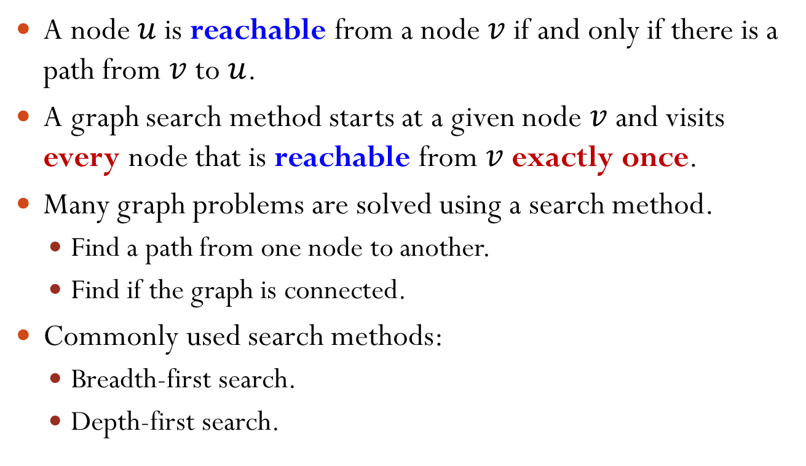
Graph Search
A node $u$ is reachable from a node $v$ if and only if there is a path from $v$ to $u$.
A graph search method starts at a given node $v$ and visits every node that is reachable from $v$ exactly once.
Many graph problems are solved using a search method.
Find a path from one node to another.
Find if the graph is connected.
Commonly used search methods:
Breadth-first search.
Depth-first search.

Slide 3
Breadth-First Search (BFS)
Given a start node, visit all directly connected neighbors first, then nodes 2 hops away, 3 hops away, and so on.
A
start node
A
direct neighbor
C
D
B
C
B
D
nodes 2 hops away
E
F
E
F
nodes 3 hops away
G
G
A→B→C→D→E→F→G
Notes:
Related question: What is the DFS result? A, B, E, G, C, D, F

Slide 4
Breadth-First Search (BFS) Implementation
BFS can be implemented using a queue.
BFS(s) { queue q; // An empty queue visit s and mark s as visited; q.enqueue(s);
while(!q.isEmpty()) { v = q.dequeue(); for(each node u adjacent to v) { if(u is not visited) { visit u and mark u as visited; q.enqueue(u);
} } } }

Slide 5
Breadth-First Search (BFS) Example
A
A
Start node is node A.
C
D
B
C
B
D
BFS(s) { queue q; // An empty queue visit s and mark s as visited; q.enqueue(s);
while(!q.isEmpty()) { v = q.dequeue(); for(each node u adjacent to v) { if(u is not visited) { visit u and mark u as visited; q.enqueue(u);
} } } }
E
F
E
F
G
G
Queue:
A
B
C
D
E
F
G
Visit Order:
A
B
C
D
E
F
G
Notes:
In the second iteration, when v = q.dequeue = “B”, actually we will visit A, C, and E.
However, A and C are already visited. Thus, we only visit E and enqueue E into the queue.

Slide 6
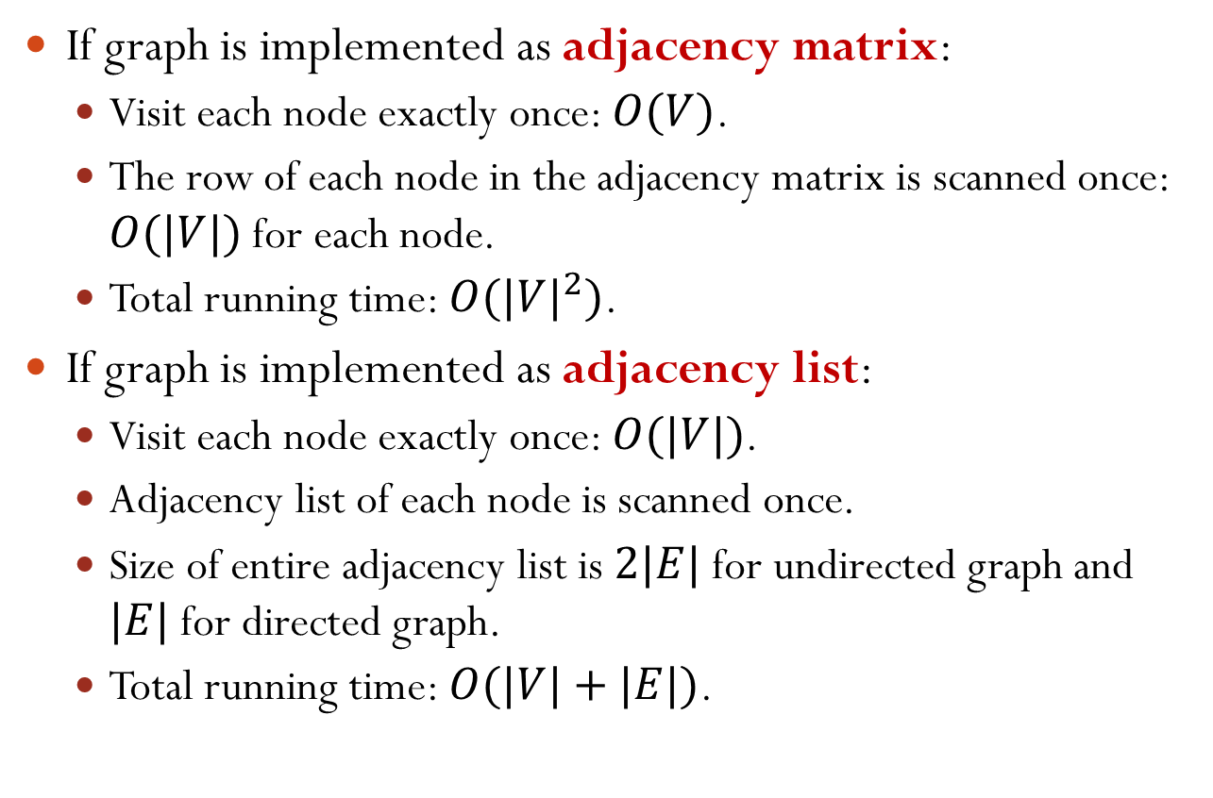
Breadth-First Search (BFS) Time Complexity
If graph is implemented as adjacency matrix:
Visit each node exactly once: $O(V)$.
The row of each node in the adjacency matrix is scanned once: $O(|V|)$ for each node.
Total running time: $O({|V|}^{2})$.
If graph is implemented as adjacency list:
Visit each node exactly once: $O(|V|)$.
Adjacency list of each node is scanned once.
Size of entire adjacency list is $2|E|$ for undirected graph and $|E|$ for directed graph.
Total running time: $O(|V|+|E|)$.

Slide 7
Depth-First Search (DFS)
DFS(v) { visit v; mark v as visited; for(each node u adjacent to v) if(u is not visited) DFS(u); }
How to mark a node “visited”?
Keep a “visited” field in the node
B
B
E
A
D
E
A
D
Time complexity?
C
C
Same as BFS

Slide 8
Traverse All the Nodes in a Graph
The graph may not be connected. How can we traverse all the nodes in the graph?
for(each node v in the graph) if(v is not visited) DFS(v);
B
E
G
A
D
F
C
Notes:
Note: DFS(v) will mark those reachable nodes as “visited”.

